Slide 1
Simple Linux
Network programming
2014/09/19

Slide 2
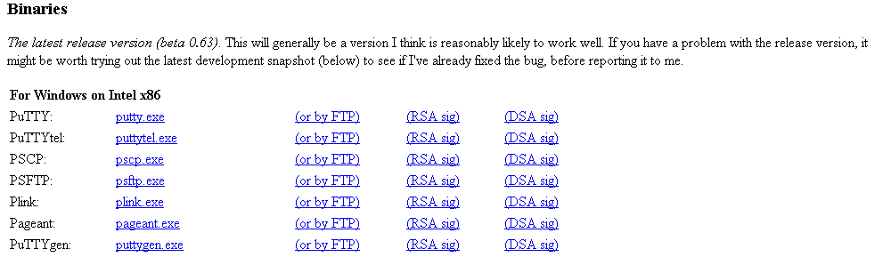
To start with...
Download putty.exe
http://www.chiark.greenend.org.uk/~sgtatham/putty/download.html
Or google putty

Slide 3
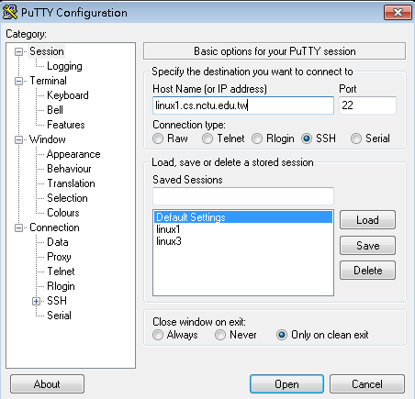
To start with... (Continued)
linux1.cs.nctu.edu.tw
linux2.cs.nctu.edu.tw
linux3.cs.nctu.edu.tw
linux4.cs.nctu.edu.tw
linux5.cs.nctu.edu.tw
linux6.cs.nctu.edu.tw

Slide 4
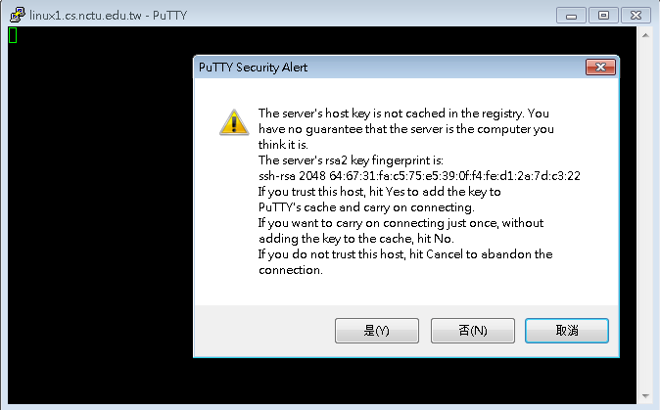
To start with... (Continued)

Slide 5
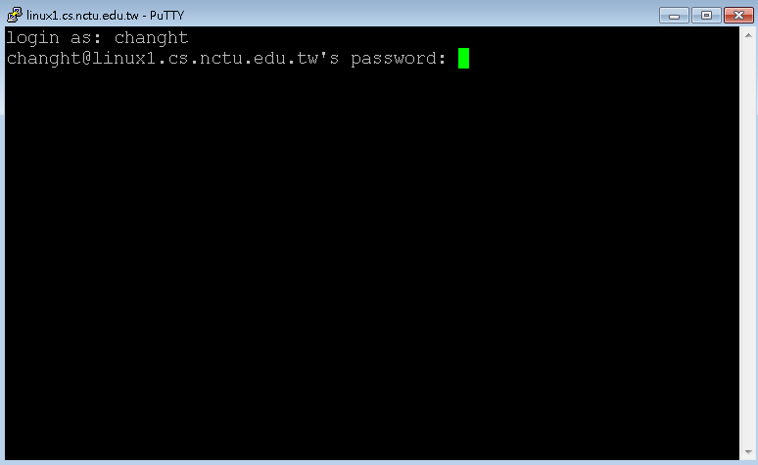
To start with... (Continued)

Slide 6
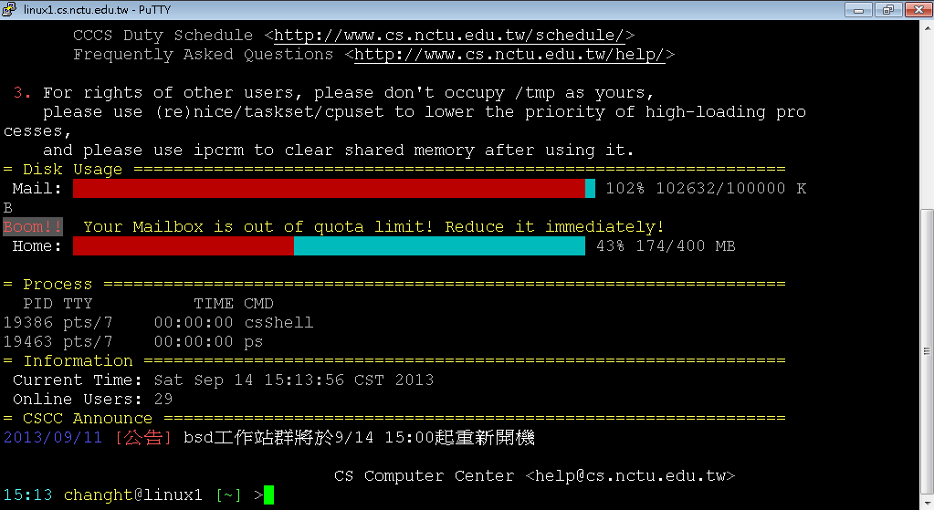
To start with... (Continued)

Slide 7
To start with... (Continued)
account@server hostname [current directory]
You can type “ls”, which means “list “, to show all the files in the home directory.
command | explanation
ls ~ | List contents in user home directory.
ls . | List contents in current directory.
ls .. | List contents in parent directory.

Slide 8
Important Linux command
command | explanation | 中文解釋
ls | List directory contents | 把現在資料夾下的檔案顯示出來
pwd | Print name from working directory | 看現在在哪個資料夾底下
mkdir <dir> | Make directories | 建立資料夾
cd <dir> | Change directory | 換資料夾
mv <src file> <dst file> | Move (rename) file | 移動檔案 (重新命名) 檔案
cp <src file> <dst file> | Copy file | 複製檔案
rm <file> | Remove file | 刪除檔案
clear | Clean up the screen | 把畫面清乾淨

Slide 9
Important Linux command (Continued)
Use command ‘man’ to discover more usages.
man ls
ls –a : show all files, including files starting with . , which are hidden files.
ls -l : show long information of contents.
ls –al : show all the files and their long information.
ls <path> : show the content of given path
You can also man the function you may use in the program.
man printf
man strtok

Slide 10
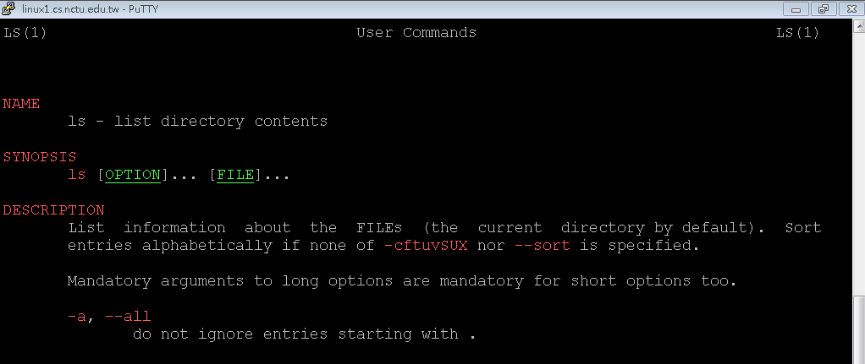
Important Linux command (Continued)

Slide 11
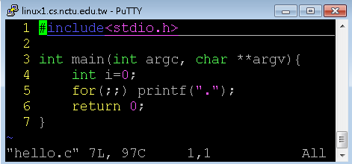
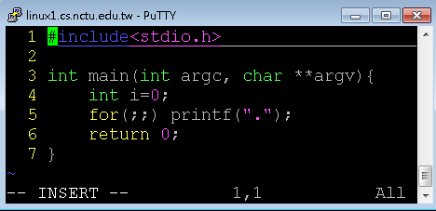
Let’s start programming – VIM
vim is a text editor
vim hello.c
Press ”insert” or “i” to enter insert mode, or you can type nothing.
Notes:
http://zh.wikipedia.org/wiki/Vim

Slide 12
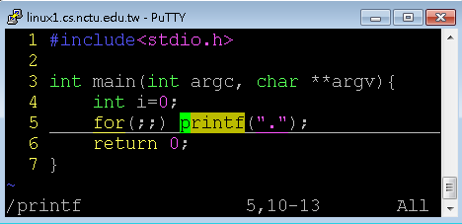
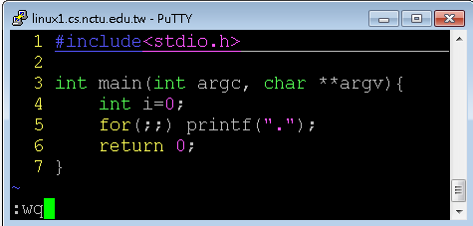
Let’s start programming – VIM (Continued)
Press “Esc” to enter back to normal mode, where you can type some commands, including “:wq” for saving and leaving, “:q!” for leaving without saving, “/printf” for searching the string “printf”.
You can pick up other usage by your self.

Slide 13
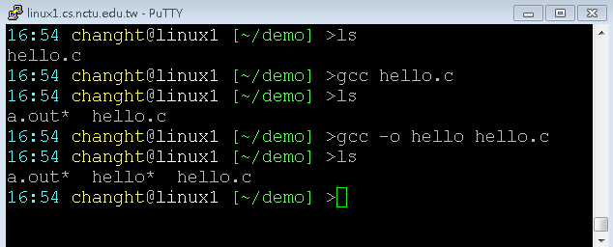
Let’s start programming – GCC/G++
gcc/g++ –o <output> <filename>
-o
Binary produced will be the same name as assigned.
If –o is not provide, a.out will be default output.

Slide 14
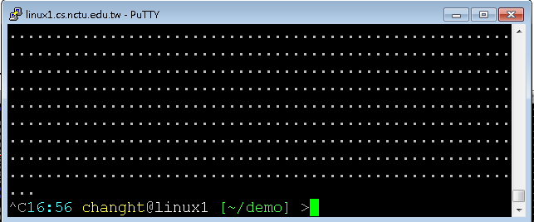
Let’s start programming – Execute and Forced Terminate
Execute
./a.out
./hello
~/demo/a.out
~/demo/hello
Forced Terminate
Ctrl+c

Slide 15
More explanation

Slide 16
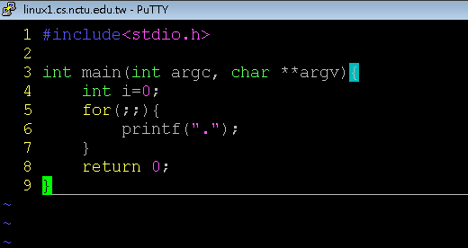
Argument variable
Argument count
Argument vector

Slide 17

Argument variable
Int main ( int argc, char** argv)
argc
Integer
The sum of given arguments count, including the binary name.
argv
Char** (string array)
a string array that holds arguments.

Slide 18
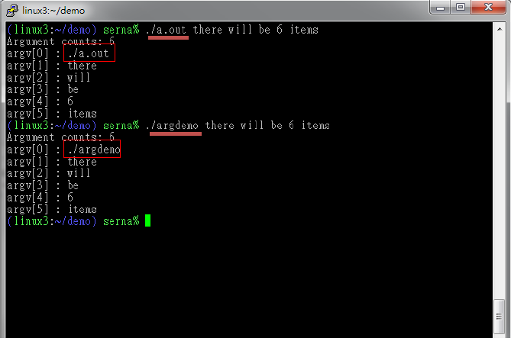
Argument variable

Slide 19
Process commands
ps
report a snapshot of the current processes.
ps u
All of your process in difference login session.
Get process ID
kill
terminate or signal a process
When a process doesn’t went your way or out of control, use this command to terminate it
kill <pid>

Slide 20
Network commands
ifconfig
Show current system NIC
eth* as intel Ethernet card
Placed in /sbin/ifconfig
ping <host IP>
Send ICMP packet to host
Simple test if an server is alive
Not working if firewall is set.
Windows 7 default
telnet <host IP> <host Port>
User interface to the TELNET protocol
Not only TELNET protocol
A simple but solid text based network client

Slide 21
Run Program in Linux
Every command is a executable binary
ls -> /bin/ls
vim -> /usr/bin/vim
Environment variables
env
PATH=/usr/local/bin:/usr/bin:/bin:/opt/bin
When user commit an command, if it wasn‘t a shell‘s builtin command, OS will try to put each environment variable in front of the command and find that binary for execute.
That means we can‘t just simply type a.out and hope to execute the program we compiled
You have to detetmine the file path of the output binary.
./a.out
~/demo/a.out

Slide 22
Homework
String processing

Slide 23
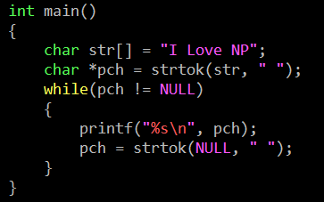
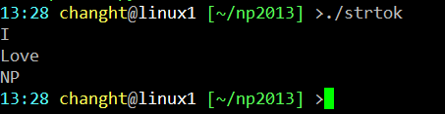
String - strtok
char * strtok ( char * str, const char * delimiters );
CODE
OUTPUT

Slide 24
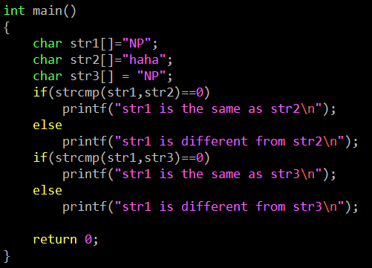

String - strcmp
int strcmp ( const char * str1, const char * str2 );
CODE
OUTPUT

Slide 25
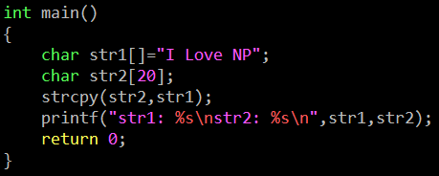

String - strcpy
char * strcpy ( char * destination, const char * source );
CODE
OUTPUT

Slide 26
Homework
Warm-up mini program (10%)
Due date 10/8 23:59
if you can’t submit it on time, your score will *0.75 for one day.
In this mini program, you will write a program (C or C++) with three commands. First, your program can reverse the string that you type. Second, it can split the string with specific character. Third, the program can terminate itself by the command .
You have to submit your code to e3 system, compress your code with zip file, and renamed as your student ID (e.g. 0256521.zip). https://dcpc.nctu.edu.tw/
If you have any questions, please discuss with TAs and classmates in our forum. http://nsl22.cs.nctu.edu.tw

Slide 27
Homework
The size of the string in the test file will be less than 100.
The string in the test file would not contain space.
We just test “reverse”, “split”, “exit” commands, you don’t have to process error commands.
The split token will be a to e.

Slide 28
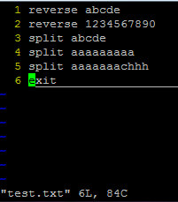
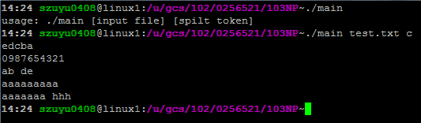
DEMO

Slide 29
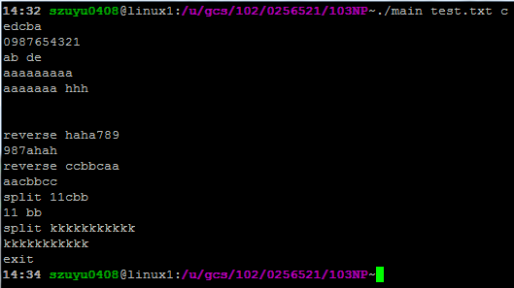
DEMO

Slide 30
Q & A

